Slide 1

MassHealth Presentation for PromotePrevent Commission
Executive Office of Health & Human Services
January 23,2018

Slide 2
MassHealth Payment and Care Delivery Innovation (PCDI)
The Executive Office of Health and Human Services (EOHHS) is committed to a sustainable, robust MassHealth program for its 1.8 million members
EOHHS is making changes to MassHealth for managed care-eligible members – introducing ACOs and Community Partners (CPs) to emphasize care coordination and member-centric care
ACOs have groups of primary care providers (PCPs) and other providers who work together to improve member care coordination and better meet overall health care needs
Community Partners (CPs) are community-based experts who will provide care coordination services to and connect members with available behavioral health and LTSS services. CPs will be available to certain members with high needs as determined by MassHealth or the ACO/MCO. Providers make referrals for consideration.
Notes:
ACOs:
Have an enhanced role for primary care,
Are rewarded for value – better cost and outcomes – not volume
Have a major and unique focus on better integrating our members’ physical, behavioral health (BH), and long term services and supports (LTSS) needs, as well as building linkages to social services

Slide 3
Delivery System Reform Incentive Payment
DSRIP totals $1.8B over five years and supports four main funding streams
Eligibility for receiving DSRIP funding will be linked explicitly to participation in MassHealth payment reform efforts
ACO (60%)
  ACOs include range of providers (e.g., CHCs)
  Supports ACO investment in primary care providers, infrastructure and capacity building
  Behavioral Health (BH) and Long Term Services and Supports (LTSS) Community Partners (CPs) and Community Service Agencies (CSAs)
  Supports BH and LTSS care coordination and CP and CSA infrastructure and capacity building
Community Partners (30%)
DSRIP Investment
Statewide Investments (6%)
  Examples include primary care, workforce, development and training, and technical assistance to ACOs and CPs
Implementation/ Oversight (4%)
  Small amount of funding will be used for DSRIP operations and implementation, including robust oversight

Slide 4
MassHealth Health Plan Options for 2018
Accountable Care Partnership Plans (Model A) | Accountable Care Partnership Plans Collaborations
Be Healthy Partnership | Baystate Health Care Alliance with Health New England
Berkshire Fallon Health Collaborative | Health Collaborative of the Berkshires with Fallon Community Health Plan
BMC HealthNet Plan Signature Alliance | Signature Healthcare Corporation with Boston Medical Center HealthNet Plan
BMC HealthNet Plan Community Alliance | Boston Accountable Care Organization with Boston Medical Center HealthNet Plan
BMC HealthNet Plan Mercy Alliance | Mercy Health Accountable Care Organization with Boston Medical Center HealthNet Plan
BMC HealthNet Plan Southcoast Alliance | Southcoast Health Network with Boston Medical Center HealthNet Plan
Fallon 365 Care | Reliant Medical Group with Fallon Community Health Plan
My Care Family | Merrimack Valley ACO with Neighborhood Health Plan
Tufts Health Together with Atrius Health | Atrius Health with Tufts Health Public Plans
Tufts Health Together with BIDCO | Beth Israel Deaconess Care Organization with Tufts Health Public Plans
Tufts Health Together with Boston Children's ACO | Children’s Hospital Integrated Care Organization with Tufts Health Public Plans
Tufts Health Together with CHA | Cambridge Health Alliance with Tufts Health Public Plans
Wellforce Care Plan | Wellforce with Fallon Community Health Plan
Primary Care ACO Plans (Model B)
Community Care Cooperative (C3)
Partners HealthCare Choice
Steward Health Choice
MCOs
Boston Medical Center Health Plan (BMCHP)
Tufts Public Plans (Tufts)
MCO-Administered ACO (Model C)
Lahey Clinical Performance Network (Participating with Boston Medical Center HealthNet Plan and Tufts Health Public Plans)
PCC Plan
Primary care Providers in the PCC Plan network

Slide 5
Important Member-Choice Dates
Below are important dates for current managed care eligible members.
For new managed care eligible members, after March 1, 2018 plan selection is the first 90 days after enrollment in an ACO/MCO, and fixed enrollment is for the remaining 275 days of the year.
All members have a new plan selection period every year.
Members can choose and enroll in a new health plan for March 1, 2018.
Plan Selection Period. Members can change health plans for any reason.
11/13/17
12/22/17
3/1/18
6/1/18
Start of Plan Selection Period
Start of Fixed Enrollment Period
Members receive letters
Members will follow their PCP into a new ACO will enroll in a new health plan.
Members enrolled in an ACO or MCO can only change their health plans for certain reasons.

Slide 6

1.89 Million
Members
$ 15
Billion
In 2016
$1.4
Billion for
Behavioral Health
Specialty Care
70% in Managed Care
40% of
State Budget
62% Mental Health
14% Addictions
24% Pharmacy
Notes:
in any given year.

Slide 7
We are strengthening treatment and supports for individuals with behavioral health needs by:
1
  Making significant investments in the behavioral health system
    Over $600 million in new funding from Fiscal Year 2016-2020 to address treatment gaps (e.g., ED boarding) and to increase service rates
    Significant expansion of capacity for addiction treatment
  Improving care coordination and health outcomes for MassHealth members with serious mental illness and/or addiction treatment needs through the creation of Behavioral Health Community Partners (BH CP), launching in June 2018
    Provides enhanced care coordination and navigation across all aspects of care – physical, behavioral, disability, social services
  Restructuring and strengthening the Department of Mental Health’s Adult Community Clinical Services (ACCS) program (formerly known as CBFS) starting in July 2018
2
3

Slide 8
1115 Waiver Provisions for Enhance Treatment for Addiction and Co-Occurring Disorders
Moves Residential Rehabilitation Services into the MassHealth Benefit
Generates $200 M in new funding over five years for the expansion of Substance Use Disorder (SUD) treatment to address the opioid crisis
Additional capacity for 500 residential rehabilitation beds
Expansion of the MassHealth benefit to cover recovery support navigators, and recovery coaches
Increased investment in Medication Assisted Treatment and critical time intervention for homeless and justice involved individuals
MassHealth and the Department of Public Health will adopt a standardized American Society of Addiction Medicine (ASAM) assessment across all SUD providers

Slide 9
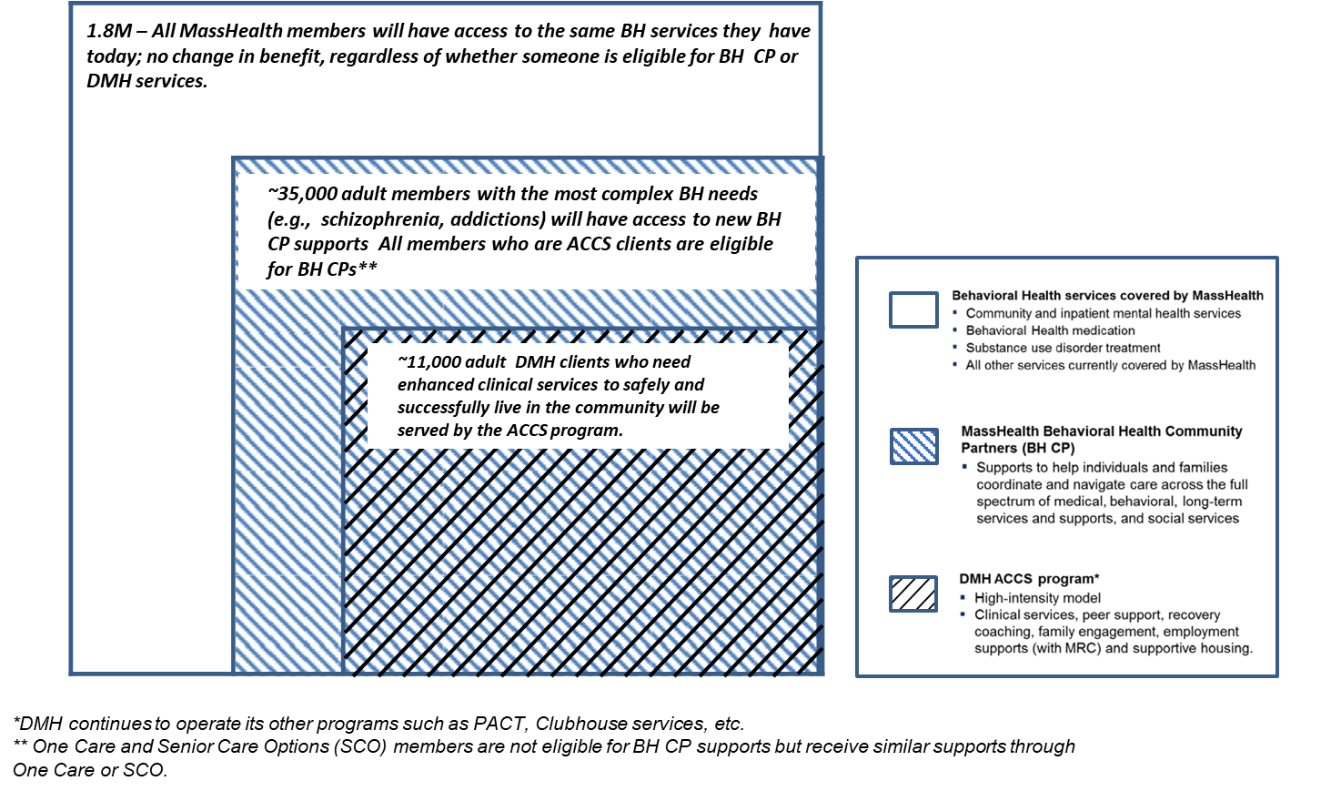
MassHealth covers behavioral health services for all members and funds enhanced services through BH CP and ACCS for members with complex needs

Slide 10
Overview: Community Partners Program
    Community Partners (CPs) are procured, contracted, and managed by MassHealth.
    There are two types of Community Partners:
Behavioral Health Community Partner (BH CP) | Long-Term Services and Supports Community Partner (LTSS CP
Responsible for care management and coordination for populations with significant BH needs | Provide LTSS care coordination and navigation to populations with complex LTSS needs

Slide 11

Behavioral Health Community Partners (BH CP): how it helps MassHealth adult members and family members navigate and coordinate care
Behavioral Health Community Partner (BH CP)
What the BH CP is doing:
Eligible member
  Actively outreach and engage individual/ families
  Assess needs, provide options and refer to services
  Coordinate with individual and providers to develop and maintain a care plan
  Help navigate medical, behavioral health, disability, social services
MassHealth plan (Accountable Care Organization or Managed Care Organization)
DMH services or other state agencies (as applicable)
Social services/ other supports (as applicable)
PCP
Medical
Specialists
Prescriptions
DMH Programs (e.g. ACCS, Clubhouses, Case Management)
Social service agencies (food/ housing subsidies, social supports)
Behavioral health
clinicians
Addiction treatment providers
DDS services
Long term
services/ supports
Other specialists
Other providers
MRC services
MassHealth contracts with Accountable Care Organizations (ACOs) and Managed Care Organizations (MCOs) to help manage care. ACOs and MCOs are required to work with BH CPs
Notes:
Talking point – BH CP functions include:
Outreach and engagement;
Comprehensive assessment and person-centered treatment planning;
Care Coordination & Care Management, including across
Medical
Behavioral Health
Long Term Services and Supports;
Care Transitions;
Medication Reconciliation;
Health and Wellness Coaching; and
Connection to Social Services and Community Resources, including Flexible Services

Slide 12
APPENDIX

Slide 13
The following is a list of the entities that have been contracted as MassHealth Behavioral Health Community Partners (1/2)

Slide 14
The following is a list of the entities that have been contracted as MassHealth Behavioral Health Community Partners (2/2)

